Slide 1
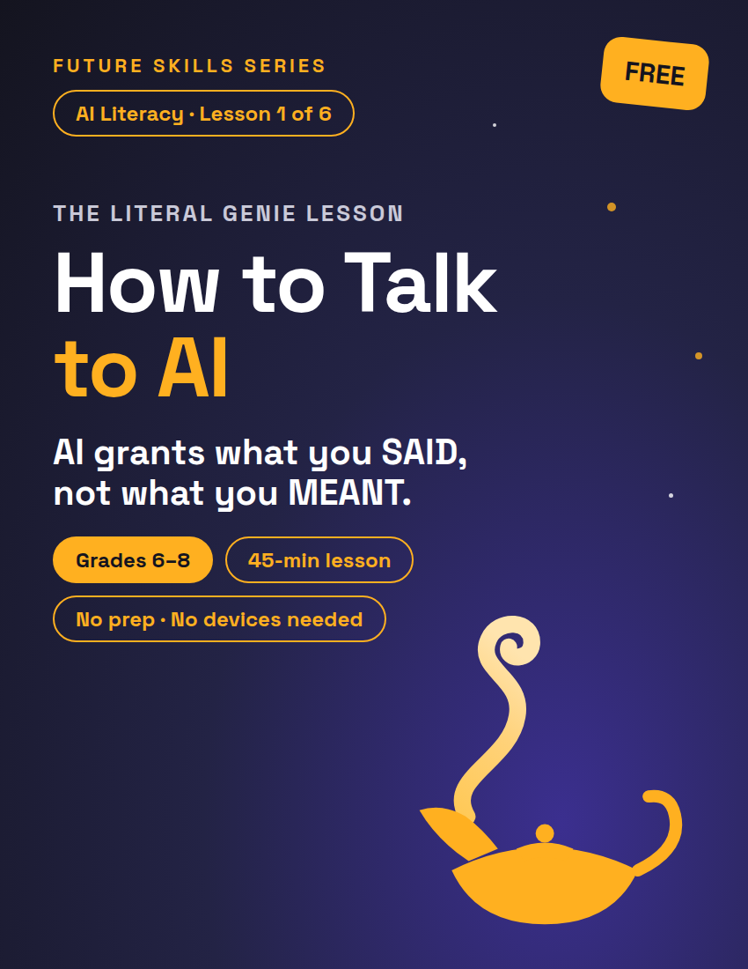
FUTURE SKILLS · AI LITERACY
THE LITERAL GENIE LESSON
How to Talk to AI
AI is a literal genie: it grants exactly what you SAID, not what you meant. Today you learn to write wishes it can't twist.
Grades 6–8
45-min lesson
No prep · No devices needed
1 / 11
Notes:
Open on this slide while students settle. Worksheet: Cursed Wish Repair Shop, one per student (2 pages). Deck follows the lesson plan block for block; minute chips top-right match it.

Slide 2
FUTURE SKILLS · AI LITERACY
8 MIN
Warm-Up — The Worst Genie Ever
I am a genie. I grant wishes EXACTLY as worded. Who's first?
"I wish I was rich." → "Done. Your name is now Rich."
"I wish for a million dollars." → "Granted — one million dollars, in play money."
"I wish school was over." → "Granted. The school building is now over... there."
2 / 11
Notes:
Take 3–4 wishes from the class and ruin every one, cheerfully. Three improv moves cover any wish: (1) take a word literally — 'rich' becomes a name; (2) fill the missing detail badly — money becomes play money; (3) grant it in the least useful form — a story becomes 'Once there was a hero. The end.' Stay in character; the genie is never mean, just literal. WHAT IF a wish is inappropriate: 'The genie doesn't grant that one. Next wish.' Nobody volunteers? Wish first yourself: 'I wish for a snack' → 'Granted: one grain of rice.' Then advance to the question.

Slide 3
FUTURE SKILLS · AI LITERACY
Whose fault was that?
?
The genie's — or the wish?
3 / 11
Notes:
Take two or three answers (the answer — the wish — stays off the slide until they say it). Then the bridge: "AI works like that genie. It doesn't know what you MEANT. It only knows what you SAID. Every AI job goes human, AI, human: you start it with the wish, the genie does the middle, and you check what comes back. Today you get good at both human parts." TRANSITION: "So how do you write a wish a genie can't twist? Lawyers figured this out a long time ago."

Slide 4
FUTURE SKILLS · AI LITERACY
10 MIN
Parts of a Genie-Proof Wish
P
R
O
Purpose
Requirements
Output
What you want + who it's for. "Explain photosynthesis to a 6th grader" beats "explain photosynthesis."
The rules: length, tone, format, include / leave out. This is what stops the genie from twisting your wish.
What should the finished answer look like? A list? A paragraph? A table? A plan?
4 / 11
Notes:
Script: "Lawyers make contracts genie-proof with clauses. Strong prompts have three parts." Write P.R.O. on the board as you go. P: "Who is this for and what do you actually want?" R: "The rules — this is the part most people skip, and it's the part that stops the twist." O: "What does done look like? A list, a table, a paragraph?" Then advance: "Let's fix one together."

Slide 5
FUTURE SKILLS · AI LITERACY
Watch one get fixed
CURSED WISH
GENIE-PROOF P.R.O. PROMPT
"help with my history essay"
"I'm writing a 7th grade history essay on the printing press. Give me 3 thesis statements and 2 pieces of evidence for each, as a bullet list. Don't write it for me."
5 / 11
Notes:
Build the right-hand prompt on the board one part at a time, naming each: Purpose (7th grade history essay, printing press), Requirements (3 theses, 2 pieces of evidence each, don't write it), Output (bullet list). With devices: run the right-hand prompt live. WHAT IF someone says it's too long: count it — three sentences. "Three sentences now, or forty pages of NASA history later. Your call."

Slide 6
FUTURE SKILLS · AI LITERACY
“
AI is your editor, not your ghostwriter.
A ghostwriter writes the whole thing for you and lets you put your name on it. An editor gives a second opinion on YOUR work. See the last sentence — "don't write it for me."
6 / 11
Notes:
Say it plainly and move on; the 'Be honest with yourself' box on the worksheet repeats it. TRANSITION: "Your turn. Page 1: three kids typed cursed wishes. Fix all three — every part, P, R and O, every time. Solo. Ten minutes."

Slide 7
FUTURE SKILLS · AI LITERACY
20 MIN
Activity — Cursed Wish Repair Shop
1
Repair · 10 min
Solo. Fix Amara's, Mateo's and Yuki's cursed wishes on page 1 — all three parts, P, R and O, every time.
2
Break it · 7 min
Swap sheets. Be the Worst Genie Ever on page 2 of your partner's sheet: say each twist out loud, check the boxes, write your best one. Swap back.
3
Showcase · 3 min
Two or three before-and-afters read aloud. With devices: run the best one live and say what came out right and what came out wrong.
7 / 11
Notes:
REPAIR: circulate; read a stuck student's repair aloud in a genie voice. WHAT IF the same repair three times: "What does Mateo need that Yuki doesn't? A plan is not a story — O has to change." Finished early → Extension (a wish that can't be genie-proofed in 50 words). TRANSITION at 10 min: "Pens down. Swap sheets. You are now the Worst Genie Ever, and page 2 is where you do your damage." BREAK IT: put the next slide up. WHAT IF a partner checks every box: make them say the twist out loud — no twist, the ✓ stands. SWAP BACK: "Sheets back with their owners. Genies, point at the ONE wish you could NOT twist. That's the one we want to hear." SHOWCASE: 2–3 pairs. WHAT IF the live AI answer is bad: "Which part of the wish let it do that?" Add a rule, run it again. Then: "Your OWN sheet, bottom of page 2. Before you write, one more rule about genies."

Slide 8
FUTURE SKILLS · AI LITERACY
Genie-Proof Checklist
P — Says what they want AND who it's for?
R — Gives at least 2 rules (length, tone, format, include / leave out)?
O — Says what the finished answer should look like?
Genie test — you tried to twist it and couldn't? ✓ = genie-proof
8 / 11
Notes:
Leave this up during Break it. Students score their PARTNER's three wishes on the partner's sheet. Exemplar repairs to compare against — Amara: "I'm a 7th grader making a one-page science poster about black holes, due Friday. Give me 5 amazing facts, each under 20 words, written so a 5th grader could get it. No math formulas." Mateo: "I'm 12 and get $15 a week. I want $120 headphones in 10 weeks. Make a simple weekly savings plan as a table, and give 2 tips for not spending it on snacks." Yuki: "Write the opening paragraph (max 100 words) of an anime-style story about a shy kid whose sketchbook drawings come to life. Mysterious tone, end on a cliffhanger." Sneakiest-twist key: a twist counts if it obeys every word. Amara — no 'under 20 words' → each fact is a page. Mateo — no time limit → a 40-year plan, 6 cents a week. Yuki — no length → one sentence again.

Slide 9
FUTURE SKILLS · AI LITERACY
1 MIN
“
Genies are tricksters.
AI can grant your wish with made-up facts — and sound completely sure. Anything checkable — a name, a date, a number — gets checked somewhere real before you use it.
9 / 11
Notes:
First minute of the plan's 7-min Exit Ticket block; sheets are back with their owners. Script: "Genies are tricksters. AI can grant your wish with made-up facts, and sound sure. Anything checkable — a name, a date, a number — gets checked somewhere real before you use it." This rule is what Exit Ticket #2 assesses (ISTE 1.3.b). Do NOT reveal which sentence in the printed genie answer is wrong.

Slide 10
FUTURE SKILLS · AI LITERACY
6 MIN
Exit Ticket — Last Check (your own sheet, page 2)
1. Write one genie-proof prompt you could really use this week for another class — P, R and O.
Then cover all but your first five words: if that was the whole wish, what would the genie hand back?
2. Read the genie's black-hole answer. Which sentence would you double-check?
Write that sentence — and where you would check it (a real place).
10 / 11
Notes:
Solo, 6 minutes. Collect. KEY — Exit #1: any prompt with P, R and O present and specific; part two is proficient if it shows the short prompt lets the genie choose ("it would explain what 6th grade math is"). Exit #2: the planted fact is "first-ever photo of a black hole in 2009" — false; the Event Horizon Telescope image of M87's black hole was released in April 2019. Proficient = names that sentence AND a real place to check it (science textbook, NASA's website, a librarian). Accept a student who flags another sentence as checkable — spotting a checkable claim is the skill. Not accepted: "I'd check it on AI." WHAT IF "it all sounds right": "Which sentence has a number or a date in it? Start there."

Slide 11
FUTURE SKILLS · AI LITERACY
Use AI to think WITH you, not FOR you.
Be honest with yourself: if the genie does your homework, your name is on a wish you never earned — and you'd know it.
11 / 11
Notes:
Close on this. This lesson stands alone. Next in the unit: What's in the Playlist? (Lesson 2 — in the unit bundle, or sold separately) — where an AI's answers even come from.

